Slide 1




Figures and Tables
Notes:
Thank you for allowing me to present our ongoing research on behalf of the COVIRT microbial subgroup. I have no conflicts of interest of financial disclosures.

Slide 2
Table 1. Overview of Meta-analysis dataset Clinical Characteristics.
Table 1. Overview of Meta-analysis dataset Clinical Characteristics n=86
Variable | Uninfected | Community Acquired pneumonia | COVID19
case | 29 (33.72%) | 25 (29.07%) | 32(37.21%)
Sex
female | 4 (18.18%) | 8 (36.36%) | 10 (45.45%)
male | 5 (13.15%) | 11 (28.94%) | 22 (57.89%)
unspecified | 20 (76.92%) | 6(23.07%) | 0 (0%)
Reads
paired | 29 (37.18%) | 25 (32.05%) | 24 (30.77%)
single | 0 (0%) | 0 (0%) | 8 (100%)
unspecified | 0 (0%) | 0 (0%) | 0 (0%)
Publication
Chen | 0 (0%) | 0 (0%) | 2 (100%)
Ren | 9 (100%) | 0 (0%) | 0 (0%)
Shen | 20 (32.79%) | 25 (40.98%) | 16 (40.98%)
Wu | 0 (0%) | 0 (0%) | 1 (100%)
Xiong | 0 (0%) | 0 (0%) | 4 (100%)
Zhou | 0 (0%) | 0 (0%) | 9 (100%)
Numeric, mean ± SD (n)
Age | 53.2 ± 13.3 (n=9) | 51.2 ± 19.8 (n=17) | 47.3 ± 11.5 (n=32)
Temp. °C | - | 38.4 ± 0.91 (n=15) | 38.4 ± 0.715 (n=8)
days after onset | - | 9.07 ± 3.17 (n=14) | 12.05 ± 6.5 (n=41)
Suppl. Table 1. COVID19 Sample Characteristics
outcome | n =25
Deceased | 10 (31.25%)
Survived | 15 (46.87%)
Unspecified | 7 (21.88%)
Cough
aggravated | 1 (2.13%)
expectoration | 3 (9.38%)
intermittent | 2 (6.25%)
yes | 6 (18.75%)
Unspecified | 20 (62.5%)
days delayed hospitalization mean ± SD (n) | 5.27 ± 3.29 (n=11)
Notes:
After read filtering and batch effect sample removal, sample cohorts consisted of 29 Uninfected sampled, 25 CAP samples, and 32 COVID19 samples, bringing the total n to 86. ***
Amongst the COVID19 cohort with known survival outcomes, 10 were deceased and 15 were survived.

Slide 3
Table 2. Gene Ontologies associated with COVID19
Ontology | Depth 1 Parent(s) | feature | namespace | Depth
Molecular Function | GO:0003824 catalytic activity | hydrolase activity | GO:0016787 | 2
 |  | transferase activity | GO:0016740 | 2
 |  | transferase activity, transferring phosphorus | GO:0016772 | 3
 |  | nucleotidyltransferase activity | GO:0016779 | 4
 | GO:0005488 binding | ion binding | GO:0043167 | 2
Biological Process | GO:0008152 metabolic process | organic substance metabolic process | GO:0071704 | 2
 |  | primary metabolic process | GO:0044238 | 2
 |  | biosynthetic process | GO:0009058 | 2
 |  | nitrogen compound metabolic process | GO:0006807 | 2
 |  | macromolecule metabolic process | GO:0043170 | 3
 |  | organic cyclic compound metabolic process | GO:1901360 | 3
 |  | organonitrogen compound metabolic process | GO:1901564 | 3
 |  | heterocycle metabolic process | GO:0046483 | 3
 | GO:0008152 metabolic process | GO:0009987 cellular process | cellular metabolic process | GO:0044237 | 2
 |  | cellular nitrogen compound metabolic process | GO:0034641 | 3
 |  | organic substance biosynthetic process | GO:1901576 | 3
 |  | cellular biosynthetic process | GO:0044249 | 3
 |  | cellular macromolecule metabolic process | GO:0044260 | 4
 | GO:0065007 biol. Regulation | regulation of biological process | GO:0050789 | 2
 |  | regulation of cellular process | GO:0050794 | 3
 | GO:0044419 interspecies interaction between organisms | modulation of process of other organism | GO:0035821 | 2
 |  | symbiotic process | GO:0044403 | 2
 |  | viral process | GO:0016032 | 3
 |  | interaction with host | GO:0051701 | 3
 |  | Mod. of process of other organism in symbiotic interact | GO:0051817 | 3
 |  | modulation by symbiont of host process | GO:0044003 | 4
 |  | modulation by virus of host process | GO:0019048 | 5
 |  | modulation by symbiont of host cellular process | GO:0044068 | 5
 |  | modulation by virus of host cellular process | GO:0019054 | 6
Notes:
30 out of a total of 13,534 Gene ontologies were associated with COVID19 when compared to community acquired pneumonia and uninfected patients using a pvalue cutoff of 0.05 with BH mutltiple test correction (Controlling for random effects of publication and patient).
Sig. go terms were comprised of 6 Depth 1 Parents involving catalytic activity, binding, metabolic and cellular processes ,biological regulation, and interspecies interaction between organisms.

Slide 4
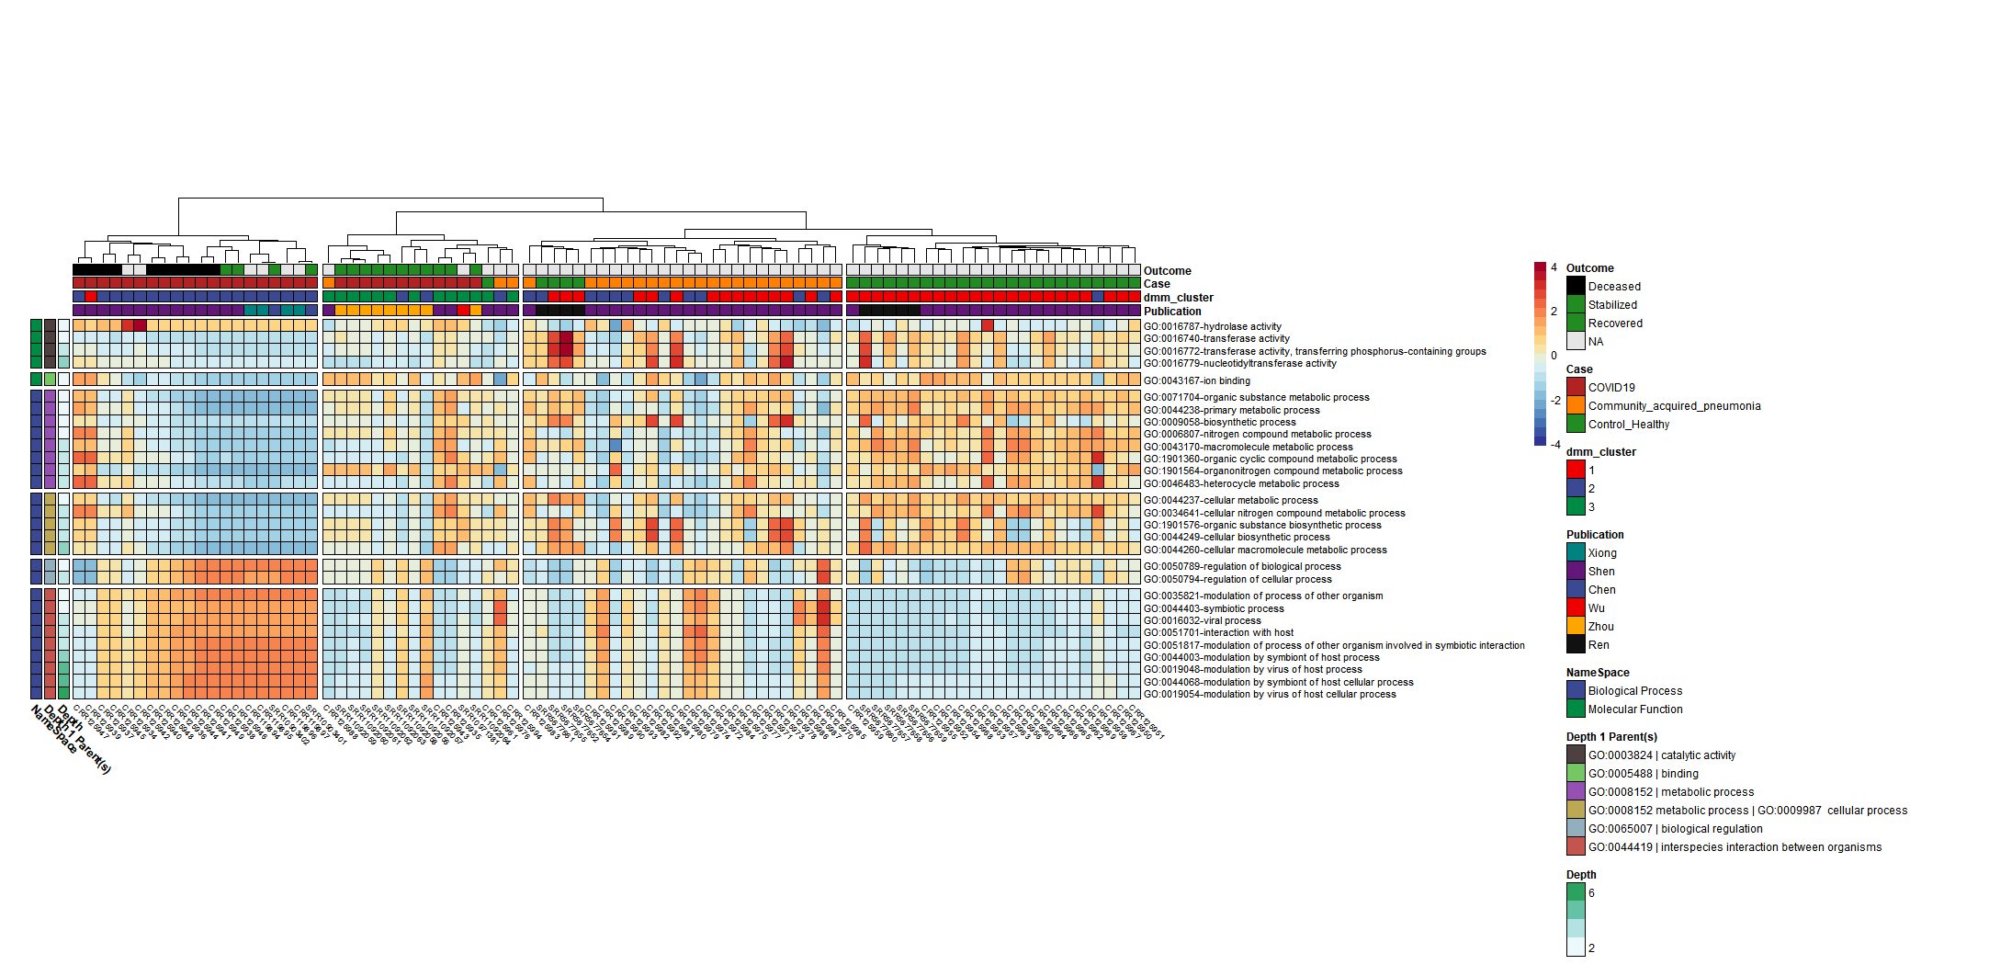
Figure 1. Microbially derived gene ontology functional annotations associated with COVID19.
Uninfected
Figure 1. Microbially derived gene ontology functional annotations associated with COVID19. Comparisons were conducted using Maaslin2, controlling for publication and patient with Benjamini Hochber multiple test comparison (q<0.05)
Notes:
Significant Terms of interest associated with COVID19 include hydrolase/transferase activity transferring phosphorus, and nucleotidyltransferase activity, and ion binding.
Additionally, Results from the Dirichlet Multinomial Mixtures clustering analysis using all 13,534 Gene ontologies counts resulted in a best model fit using 3 distinct dmm clusters that were significantly associated with each case type p<0.0001***.

Slide 5
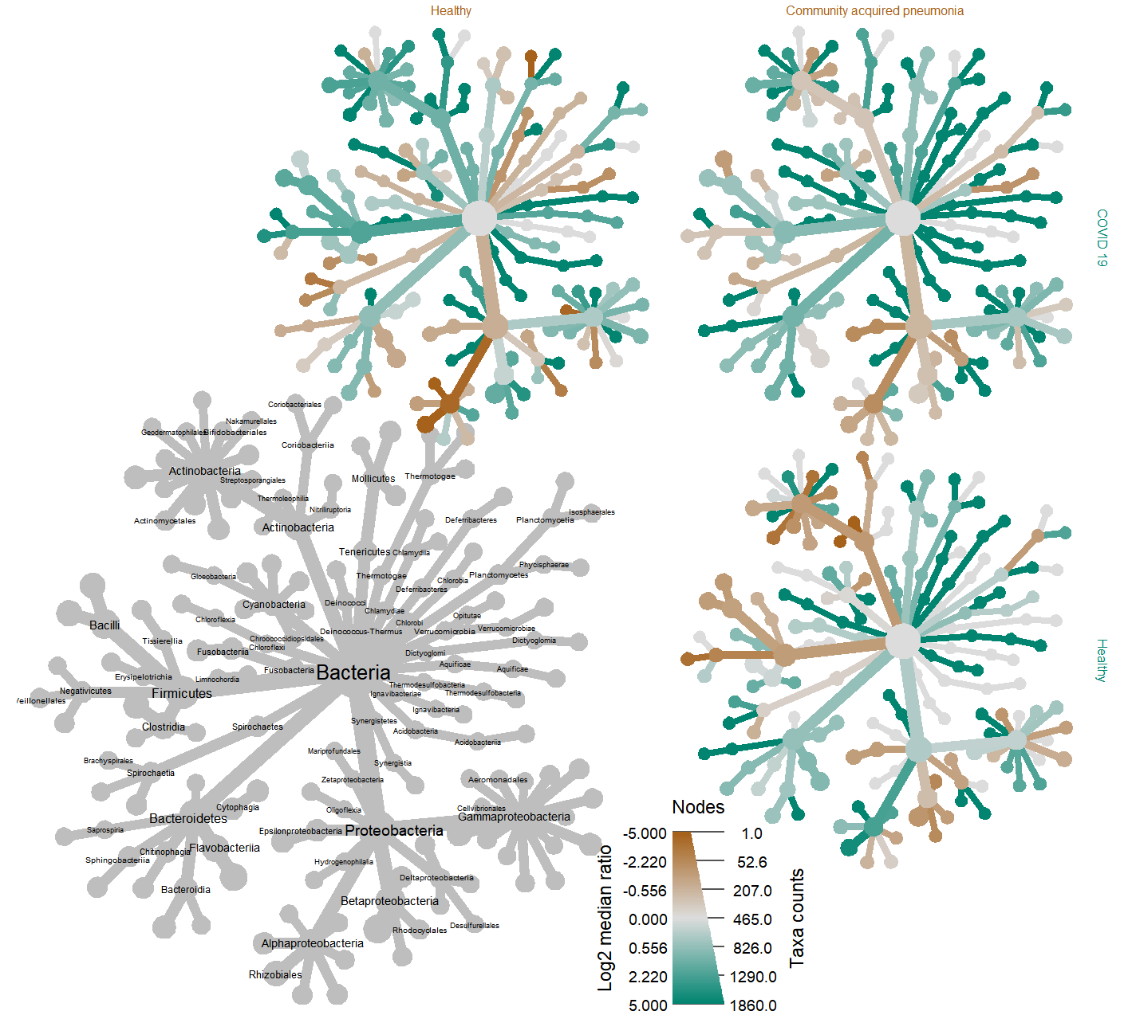
Figure 2 taxonomic comparison of the log2 median ratio by case type.
Community acquired pneumonia
Uninfected
Sphingomonas
treatment | median ratio | p | q
CAP | -2.05 | 0.007 | <0.05 | *
Uninfected | -2.80 | <0.0001 | <0.0005 | ***
COVID19
Uninfected
Supplementary Table of log2 diff. taxa
Notes:
Taxonomic analysis revealed a statistically significant decrease in log2 median ration of several species *** belonging to the genus Sphingomonas when compared to both the uninfected (p<0.0001, q <0.001) and CAP cohorts (p<0.005,q <0.05) cohorts (table X). This finding supports previous reports regarding an association with Sphingomonas, which is commonly known as an opportunistic pathogen found in healthcare-associated pneumonia.
Sig. GO Terms derived from Sphingomonas proteins in the COVID19 samples were
hydrogen peroxide catabolic process [GO:0042744];
response to oxidative stress [GO:0006979]
catalase activity [GO:0004096]; heme binding [GO:0020037];
metal ion binding [GO:0046872]
The catalase protein decomposes hydrogen peroxide into water and oxygen; serves to protect cells from the toxic effects of hydrogen peroxide.
So as a discussion point perhaps Sphingomonas is responding to COVID-19 conditions in the patient by expressing genes that help it to survive well under the COVID-19 disease conditions.

Slide 6
Figure 3. Microbially derived gene ontology functional annotations associated with COVID19 survival.
Figure 1. Microbially derived gene ontology functional annotations associated with COVID19 survival. Comparisons were conducted using Maaslin2, controlling for publication and patient with Benjamini Hochber multiple test comparison (q<0.05)
Notes:
Significant Terms of interest associated with COVID19 include hydrolase/transferase activity transferring phosphorus, and nucleotidyltransferase activity, and ion binding.
Additionally, Results from the Dirichlet Multinomial Mixtures clustering analysis using all 13,534 Gene ontologies counts resulted in a best model fit using 3 distinct dmm clusters that were significantly associated with each case type p<0.0001***.

Slide 7

Table 3. Gene Ontologies associated with COVID19 survival.
Table 4. Gene Ontologies associated with COVID19 survival. GO terms comparisons were conducted using Maaslin2, controlling for random effect of patient and using Benjamini Hochber multiple test comparison (q<0.05).
Ontology | Gene ontology nomenclature | coef | stderr | pval | qval | namespace | depth
Biological Process | phosphorylation | 2.897 | 0.888 | <0.001 | 0.036 | GO:0016310 | 3
 | transition metal ion binding | -0.545 | 0.106 | <0.001 | <0.001 | GO:0046914 | 4
 | magnesium ion binding | -2.336 | 0.709 | <0.001 | 0.036 | GO:0000287 | 4
 | nucleobase-containing compound biosynthetic process | -0.63 | 0.117 | <0.001 | <0.001 | GO:0034654 | 5
 | RNA phosphodiester bond hydrolysis | -1.412 | 0.402 | <0.001 | 0.024 | GO:0090501 | 5
 | RNA binding | 0.989 | 0.303 | <0.001 | 0.036 | GO:0003723 | 5
 | RNA metabolic process | -0.31 | 0.086 | <0.001 | 0.018 | GO:0016070 | 7
 | zinc ion binding | -0.88 | 0.266 | <0.001 | 0.036 | GO:0008270 | 7
 | endopeptidase activity | -0.995 | 0.309 | <0.001 | 0.037 | GO:0004175 | 5
Molecular Function | DNA recombination | -2.13 | 0.667 | <0.001 | 0.037 | GO:0006310 | 6
 | Pyrophosphatase activity | -0.326 | 0.107 | 0.002 | 0.048 | GO:0016462 | 5
 | oxidoreductase activity | 2.541 | 0.801 | 0.002 | 0.037 | GO:0016491 | 4
 | hydrolase activity, acting on acid anhydrides | -0.323 | 0.107 | 0.003 | 0.052 | GO:0016817 | 3
 | catalytic activity, acting on RNA | -0.546 | 0.174 | 0.002 | 0.039 | GO:0140098 | 2
 | organonitrogen compound catabolic process | -2.388 | 0.721 | <0.001 | 0.036 | GO:1901565 | 5
* Coefficients are directly correlated with regulation amongst patients who survived.
Notes:
We then conducted a subsequent Maaslin2 analysis amongst COVID19 samples with known survival outcomes analysis revealing notable functional profiles associated Phosphate / phosphorylation, Metal ion binding (mg,zn,etc) Nucleotide terms (DNA/RNA) Lytic activity (hydrolase, endopeptidase,etc).

Slide 8
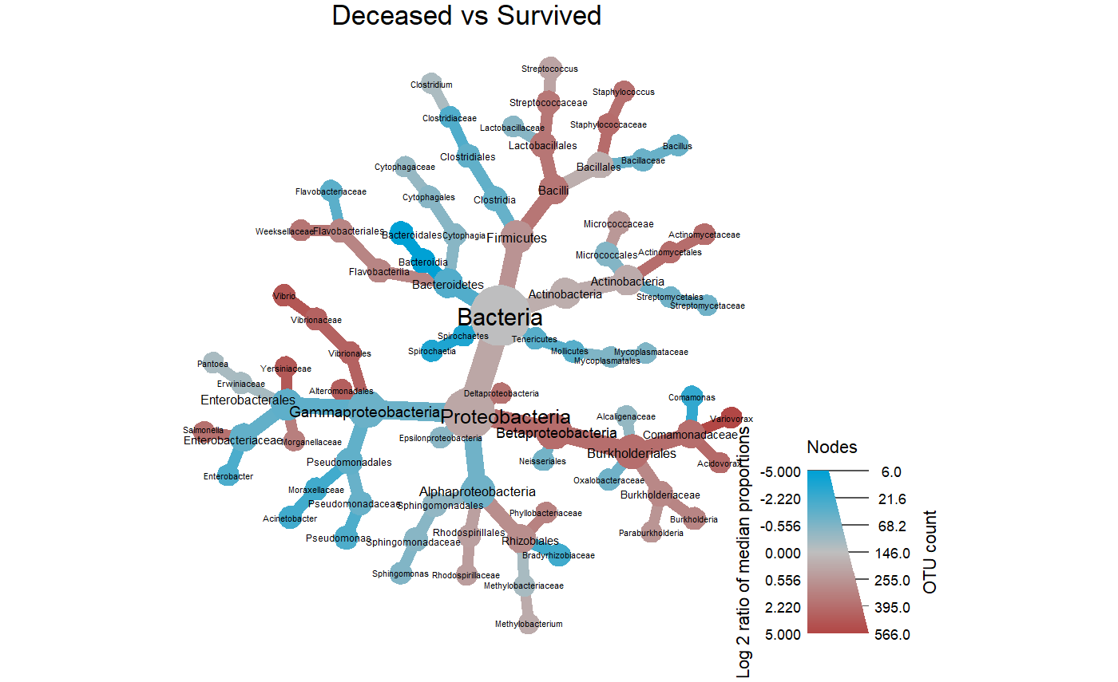
Figure 4 taxonomic comparison of the log2 median ratio by COVID19 disease outcome.
Notes:
Taxonomic analysis revealed a statistically significant decrease in log2 median ration of several species *** belonging to the genus Sphingomonas when compared to both the uninfected (p<0.0001, q <0.001) and CAP cohorts (p<0.005,q <0.05) cohorts (table X). This finding supports previous reports regarding an association with Sphingomonas, which is commonly known as an opportunistic pathogen found in healthcare-associated pneumonia.
Sig. GO Terms derived from Sphingomonas proteins in the COVID19 samples were
hydrogen peroxide catabolic process [GO:0042744];
response to oxidative stress [GO:0006979]
catalase activity [GO:0004096]; heme binding [GO:0020037];
metal ion binding [GO:0046872]
The catalase protein decomposes hydrogen peroxide into water and oxygen; serves to protect cells from the toxic effects of hydrogen peroxide.
So as a discussion point perhaps Sphingomonas is responding to COVID-19 conditions in the patient by expressing genes that help it to survive well under the COVID-19 disease conditions.

Slide 9
Table 4. Taxonomic comparisons of BALF COVID-19 samples by disease outcome
deceased vs survived
log₂ median ratio | Median diff | Mean diff | p value | q value | taxon
2.29 | 0.425 | 0.296 | 0.0264 | 0.185 | Betaproteobacteria
-5.13 | -0.103 | -0.104 | 0.0308 | 0.199 | Bacteroidia
1.84 | 0.0549 | 0.13 | 0.0137 | 0.124 | Bacilli
2.24 | 0.403 | 0.297 | 0.0163 | 0.124 | Burkholderiales
2.97 | 0.00242 | 0.0021 | 0.00353 | 0.074 | Vibrionales
-5.18 | -0.0998 | -0.102 | 0.00962 | 0.124 | Bacteroidales
3.16 | 0.00183 | 0.00171 | 0.0157 | 0.124 | Alteromonadales
2.25 | 0.361 | 0.371 | 0.000165 | 0.00691 | Comamonadaceae
2.97 | 0.00242 | 0.0021 | 0.00353 | 0.074 | Vibrionaceae
1.77 | 0.0111 | 0.0645 | 0.0475 | 0.274 | Streptococcaceae
3.61 | 0.00361 | 0.00387 | 0.0156 | 0.124 | Yersiniaceae
2.1 | 0.0047 | 0.00435 | 0.0156 | 0.124 | Salmonella
3.8 | 0.00169 | 0.00181 | 0.00492 | 0.0827 | Vibrio
5.21 | 0.405 | 0.377 | 0.000165 | 0.00691 | Variovorax
Comparisons were conducted using Wilcoxon rank sum test and adjusted for multiple test comparisons using the benajmini hochberg correction method
Notes:
Significant Terms of interest associated with COVID19 include hydrolase/transferase activity transferring phosphorus, and nucleotidyltransferase activity, and ion binding.
Additionally, Results from the Dirichlet Multinomial Mixtures clustering analysis using all 13,534 Gene ontologies counts resulted in a best model fit using 3 distinct dmm clusters that were significantly associated with each case type p<0.0001***.

